Slide 1
Lecture 4
Math Foundations Team

Slide 2
Matrix decompositions
We studied vectors and how to manipulate them in preceding lectures.
Mappings and transformations of vectors can be conveniently described in terms of operations performed by matrices.
In this lecture we shall study three aspects of matrices: how to summarize matrices, how matrices can be decomposed, and how the decompositions can be used for matrix approximations.
Towards this first we focus our attention on eigen values and eigen vectors

Slide 3
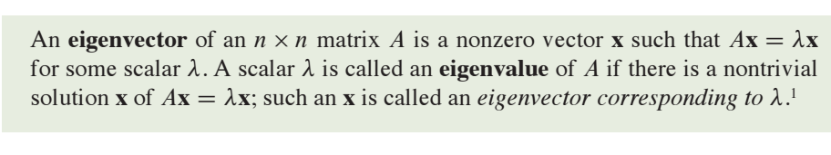
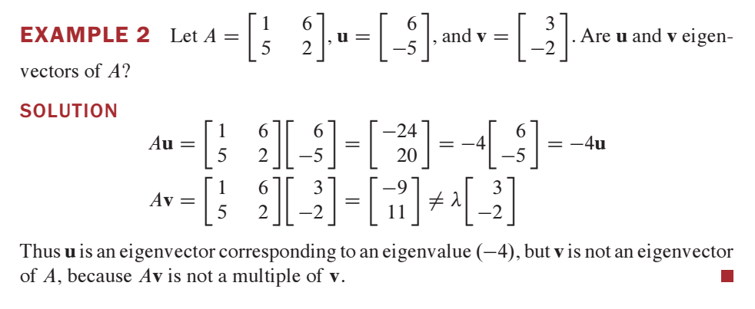
Definition of Eigen Values and Eigen Vectors

Slide 4
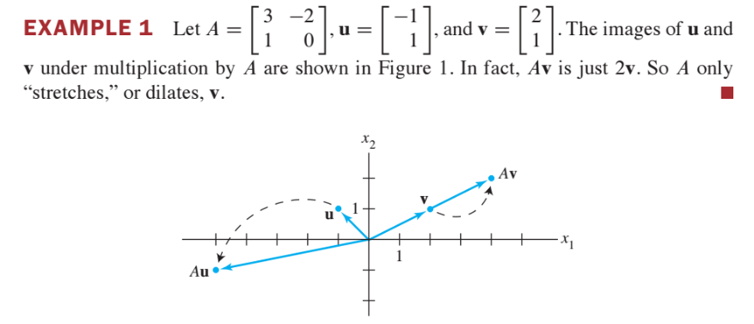
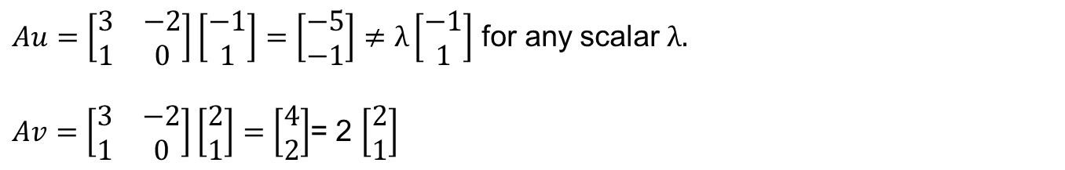
Geometrical Interpertation of Eigen Values

Slide 5
Why do we study Eigen Values
There are lot of applications of Eigen values and Eigen vectors in weather prediction, population estimation, and so on.
In ML there are many areas where eigen values and eigen vectors are used.
To analize the data, we require the matrix decomposition.
In matrix decompositions such as eigen decomposition, singular decomposition are based on eigen values and eigen vectors.
Later we will study the concept of dimensionality reduction. The methods used here such as PCA uses eigen values.

Slide 6
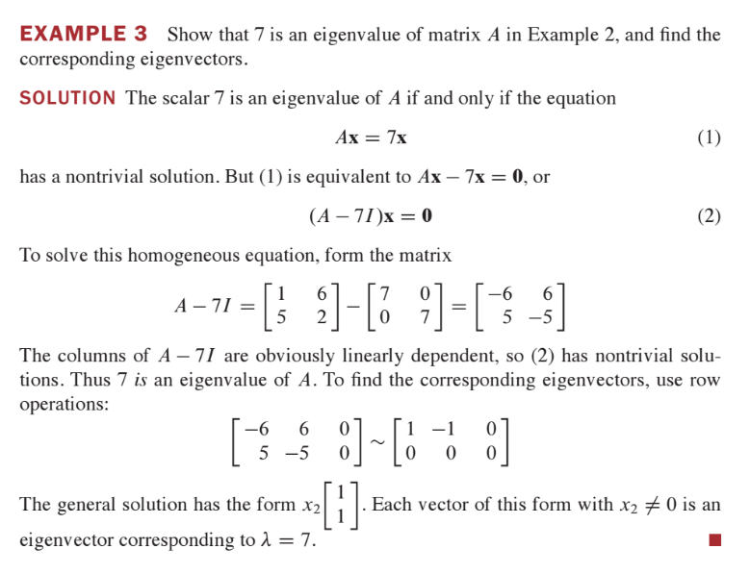
Example

Slide 7
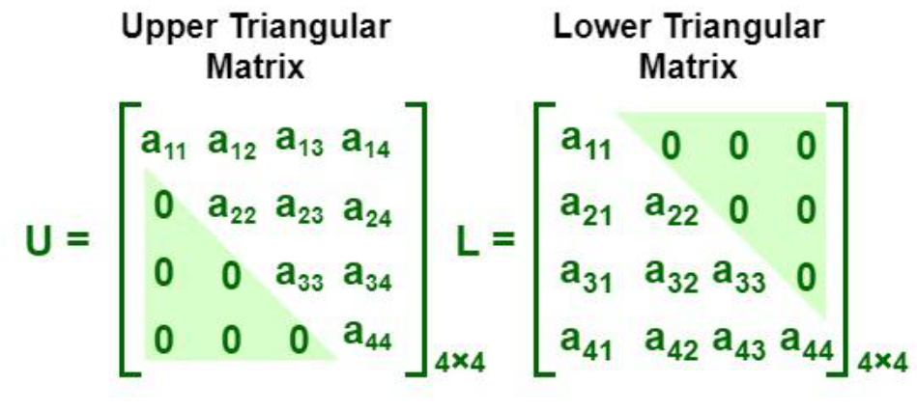
Triangular Matrices
A triangular matrix is a special case of a square matrix, where all elements above or below the principal diagonal are zeros. An upper triangular matrix is a square matrix, whose all elements below the principal diagonal are zeros. A lower triangular matrix is a square matrix, whose all elements above the principal diagonal are zeros.

Slide 8
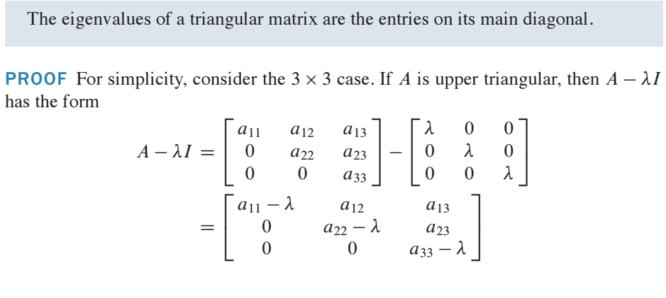
Eigen Values of a triangular Matrix
If λ = a₁₁ or a₂₂ or a₃₃, then at least one column will not have a pivot element and hence the system of homogenous equations (A – λI)X = 0 has a non-trivial solution. This means all diagonal element are Eigen values of A.

Slide 9
How to find the eigen values of a matrix
Now let us see how to find the eigen values of a matrix.
In order to find the eigen values of a amatrix A we will solve an equation called characteristic equation : det(A – λI) = 0.
In this context we require to study the determinant of a matrix.

Slide 10
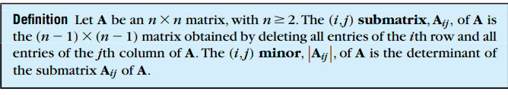

Minor and cofactor

Slide 11
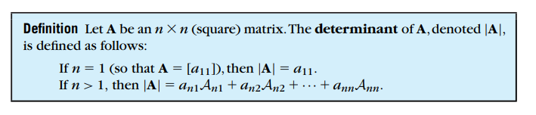
Definition of Determinant

Slide 12
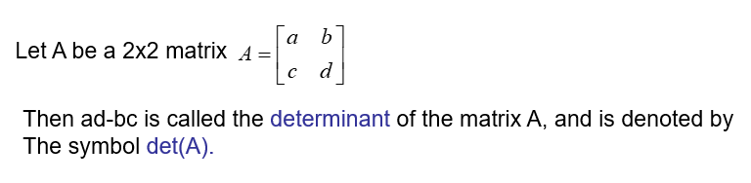

Determinant of a 2x2 matrix
If $A=\left[\begin{matrix}1 & −3 \\ 2 & 4\end{matrix}\right]$ then
$\det\left(A\right)=\left(1∗4\right)−\left(\left(−3\right)∗2\right)=10$
In the above matrix A find minor and cofactor of each entry.

Slide 13
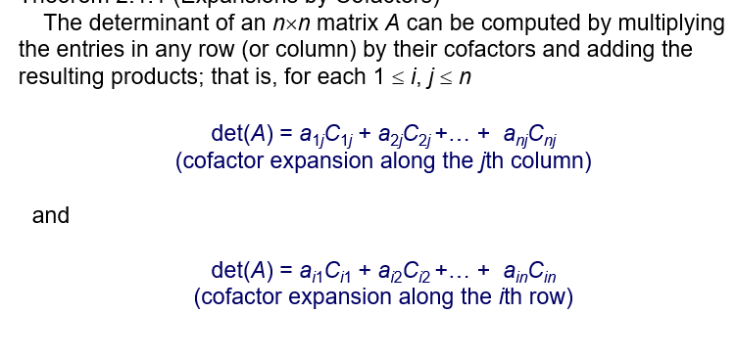
Theorem

Slide 14
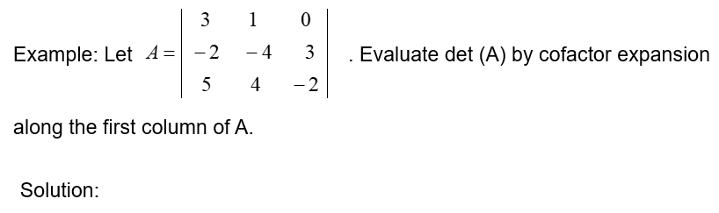

Determinant of 3x3 matrix
$$\det\left(A\right)=3\det\left(\left[\begin{matrix}−4 & 3 \\ 4 & −2\end{matrix}\right]\right)−\left(−2\right)\det\left(\left[\begin{matrix}1 & 0 \\ 4 & −2\end{matrix}\right]\right)+5\det\left(\left[\begin{matrix}1 & 0 \\ −4 & 3\end{matrix}\right]\right)$$
= (3*(-4)) + (2*(-2)) + (5*3) = -1
Ex: Evaluate det(A) by cofactor expansion along the first row.

Slide 15
Determinant and Elementary Row operations
1. Let A be an nxn matrix and B be the matrix obtained from A by interchanging any two rows of A. Then det(B) = -det(A).
2. Let A be an nxn matrix and B be the matrix obtained from A by multiplying a row by a non zero constant c. Then det(B) = c det(A).
3. Let A be an n×n matrix and let B be the matrix which results from adding a multiple of a row to another row. Then det(A)=det(B)
Note that when we compute the echelon form (Not rref) of a matrix, we use only the elementary operations 1 and 3. So we can redefine the determinant in the following way.
.

Slide 16
Alternating way of defining determinant
Definition: Let A be an nxn matrix and U be the Echelon form of A.
Then the product (-1)^{r} u₁₁u₂₂…u_{nn} is called determinant of A. Here r is
number of times we exchange the rows.

Slide 17
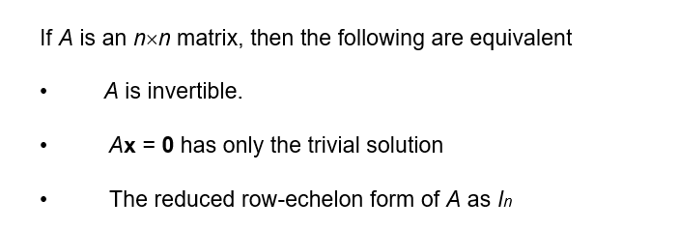
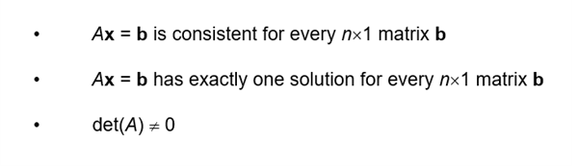
Theorem (Equivalent conditions of det(A) ≠ 0

Slide 18
How to compute Eigen values
|A – λI_{n}| is called characteristic polynomial.
|A – λI_{n}| = 0 is called characteristic equation.

Slide 19
Example 1
Find the eigen values and eigen vectors of

Slide 20
Example 1 Ctd

Slide 21
Example 1 Ctd

Slide 22
Eigen Space
Find the Eigen values and Eigen Space of the matrix
= -(λ-1)² (λ-10)
Charateristic equation is (λ-1)² (λ-10) = 0
Eigen values are 1 (repeated twice) and 10.

Slide 23
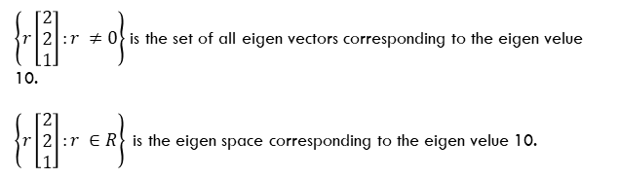
Example 2 Ctd
$\left\{r\left[\begin{matrix}2 \\ 2 \\ 1\end{matrix}\right]:r ≠0\right\}$ is the set of all eigen vectors corresponding to the eigen velue 10.
$\left\{r\left[\begin{matrix}2 \\ 2 \\ 1\end{matrix}\right]:r ∈R\right\}$is the eigen space corresponding to the eigen velue 10.

Slide 24

Example 2 Ctd
The eigen space corresponding to the eigen value 1 is
$$\left\{\left[\begin{matrix}−s−t \\ s \\ 2\end{matrix}\right]:s, t∈R\right\}$$

Slide 25
Some additional properties
A matrix and its transpose have the same eigenvalues. To see this, first note that det(A) = det(A^{T} ). Then det(A − λI ) = det((A − λI )^{T} ) = det(A^{T} − λI ^{T} ) = det(A^{T} − λI ). The last expression in the chain of equalities is the characteristic polynomial for p_{A}T (λ). Thus we have p_{A}(λ) = p_{A}T (λ) which means the characteristic polynomials are equal and so the roots of the polynomials or the eigenvalues must be equal.
The eigenspace E_{λ} is the nullspace of A − λI .
Symmetric, positive-definite matrices always have positive, real eigenvalues.

Slide 26
Some theorems
The eigenvectors x₁, x₂ . . . x_{n} of a n × n matrix A with n
distinct eigenvalues are linearly independent → why?
Given a matrix A ∈ R^{m×n} we can show that A^{T} A ∈ R^{n×n} is a symmetric, positive-definite matrix when the rank of A = n. Why is this true? Clearly A^{T} A is a symmetric matrix and it is positive definite since x ^{T} A^{T} Ax = Ax ² > 0 ∀x ∈ R^{n} \ 0 since the nullspaces of A^{T} A and A are the same, and A is a full column rank matrix.
The matrix A^{T} A is important in machine learning since it figures in the least-squares solution to a data matrix represented as A where n represents the number of features and m is the number of data vectors.

Slide 27
Spectral theorem
Theorem: If A ∈ R^{n×n} is symmetric there exists an orthonormal basis of the corresponding vector space V consisting of the eigenvectors of A, and each eigenvalue is real.
Proof: We will not attempt a full proof of this theorem but provide some intuitions about why it is true. The theorem relies on the following three statements, shown in the next slide.

Slide 28
Spectral theorem
All roots of the characteristic polynomial p_{A}(λ) are real.
For each eigenvalue λ we can compute an orthonormal basis for its eigenspace. We can string together the orthonormal bases for the different eigenvalues of A to come up with the vectors v₁, v₂...
The dimension of the eigenspace E_{λ}, called its geometric multiplicity, is the same as the algebraic multiplicity of λ which is the number of times λ appears as a root of the characteristic polynomial.
All the basis vectors from the different Eigenspaces combine to provide an orthonormal basis for R^{n}.

Slide 29
Spectral theorem
So we see that the eigenvalues of a symmetric matrix are real and eigenvectors belonging to different eigenvalues are orthogonal.
This suggests that one can string together all the orthonormal bases for the different eigenvalues and get an orthonormal basis for R^{n}.
But who is to say that when we string together the basis vectors for all the eigenvalues, we will have enough vectors to describe R^{n}? We need n basis vectors and might end up having fewer than n vectors.
If the eigenvalues are all different, we can see that we will indeed have enough basis vectors. But what about when there are repeating eignevalues?

Slide 30
Spectral theorem
We need one more piece to complete the puzzle and show that we will have enough eigenvectors to complete the orthonormal basis - this part we shall not prove!
As a consequence of the spectral theorem we can write a real symmetric matrix A as A = QΛQ^{T} where Q is an orthonormal basis (think orthonormal basis vectors for example), and Λ is a diagonal matrix consisting of non-zero entries only along the diagonal.
The spectral theorem can be used in a machine learning context since we can take the data matrix A and create a symmetric matrix out of it - A^{T} A and AA^{T} which are both used in Singular-Value Decomposition and PCA.

